Slide 1
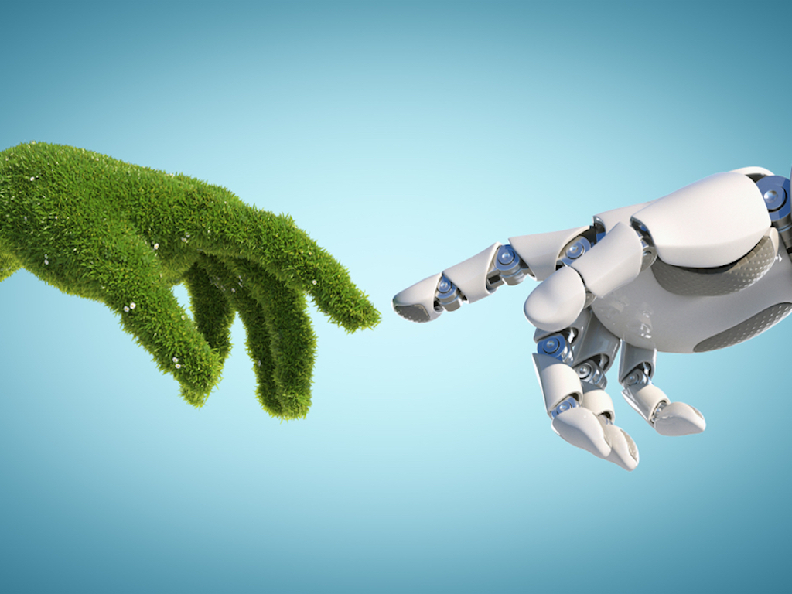

AI-Enhanced Tree Planting Planner
Supervised by: Sir Muhammad Ali Shah Fatmi

Slide 2
Idea proposed by
Taha Jawaid (21K-3881)
Imran Ali (21K-3877)
Taha Ali (21K-3867)

Slide 3
Table of Content
Introduction
Features/Literature Review
Methodology
Planning & Hardware Requirements
System Diagram

Slide 4
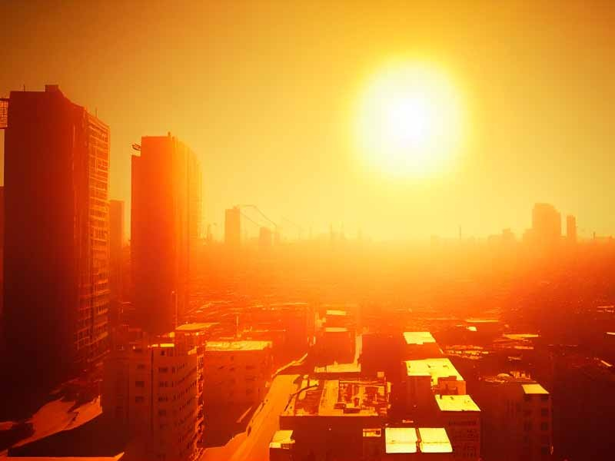
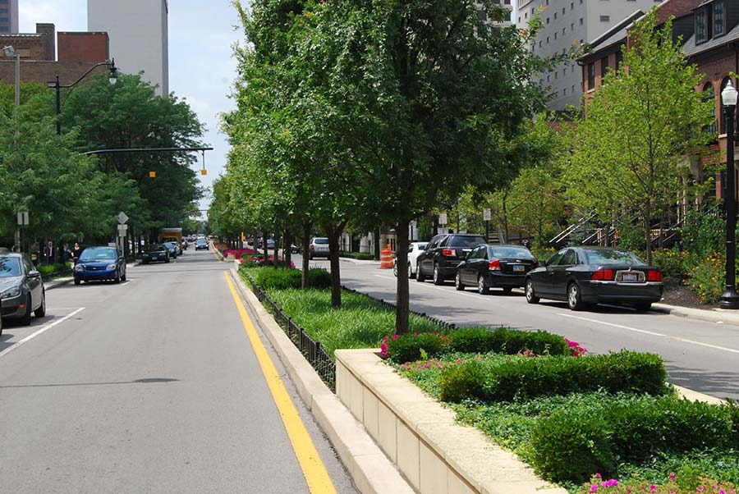
Before
After

Slide 5

How Our Project is Going To Contribute??

Slide 6
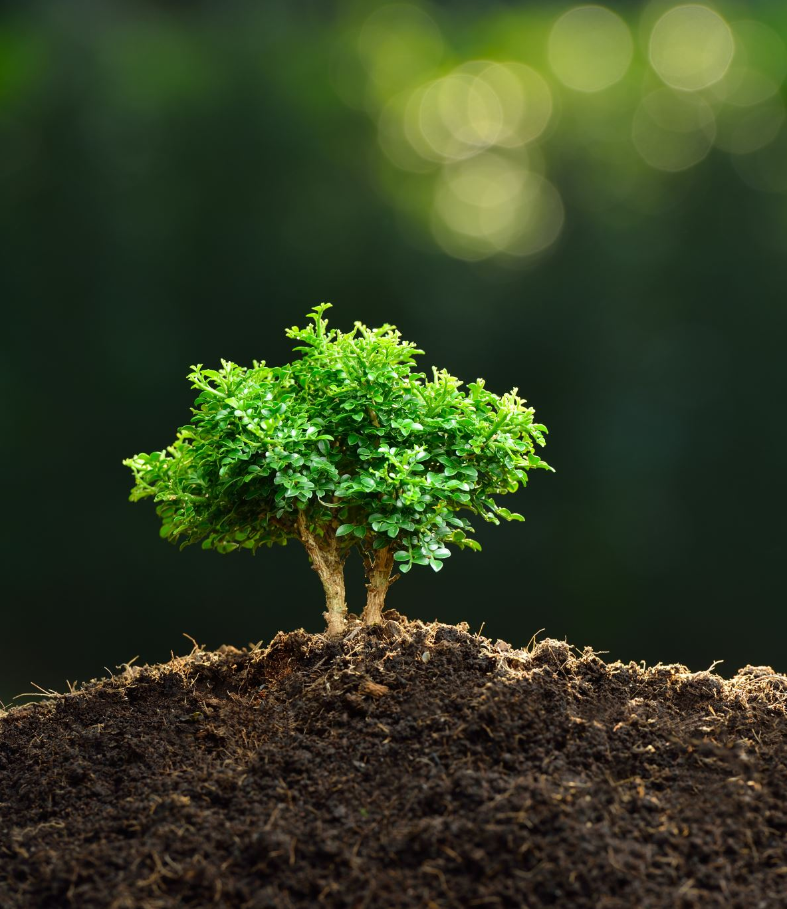
Introduction
AI-Enhanced Regional Tree Planting Predictor is a web-based application that solves the challenges facing urban polluted areas concerning heat and air quality.
The project utilizes IoT sensors to analyze the areas suffering from pollution and heat.
Our goal is to suggest places to plant trees by using AI-pre-trained models where trees will impact more than any other areas and enhance the sustainability of the environment.

Slide 7

Features/Literature Review
Planting trees is one of the most effective strategies to combat climate change by regulating temperature, improving air quality, and enhancing urban environments.
Temperature, humidity, air quality, and soil condition are key elements in determining the best locations for tree planting.
Computers and environmental sensor networks, like IoT and satellite data, improve the accuracy of tree planting recommendations and urban greening efforts.
The Punjab government's satellite monitoring system has successfully tracked environmental changes, providing valuable data to mitigate air pollution and support afforestation efforts.
Combining AI models and sensor data helps provide precise recommendations for tree planting, increasing the efficiency and environmental impact of urban greening projects.

Slide 8
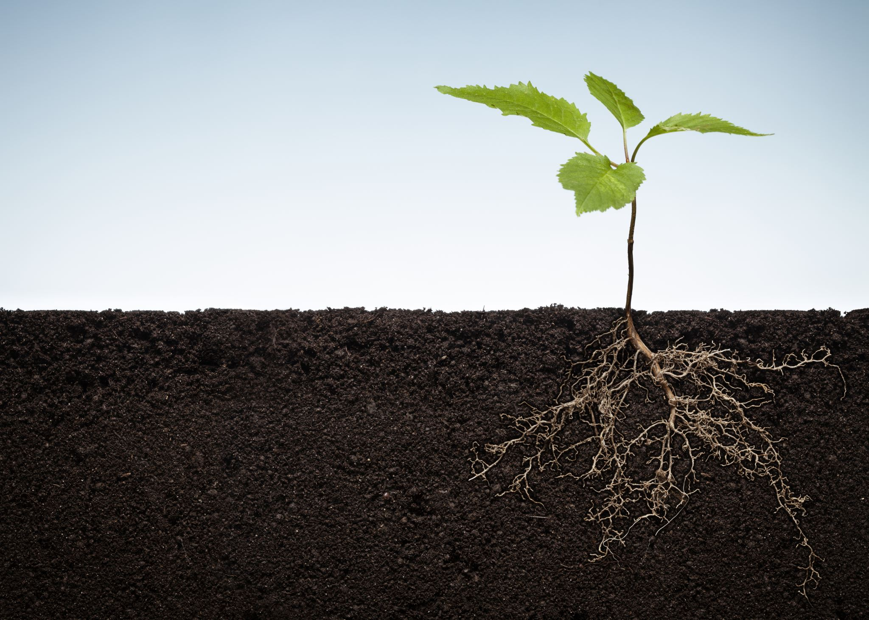
Methodology
The AI-Enhanced Regional Tree Planting Planner uses IoT sensors and Pre-trained AI models to optimize tree planting locations based on real-time environmental data.
IoT sensors will be installed in regions like Shah Latif Town and New Karachi to monitor temperature, humidity, and air quality, sending data to a central processing unit for analysis.
Pre-trained AI models will analyze environmental data, focusing on areas with high temperatures or poor air quality, using historical data to improve accuracy.
A web-based user interface will allow users to input their location and receive tree planting recommendations, displaying optimal areas through maps.
The system will prioritize areas like Sadar with rising temperatures, offering data-driven tree planting recommendations to reduce heat and improve air quality.

Slide 9
Planning and Hardware Requirements
Deploy sensors to collect real-time data on temperature, humidity, and air quality.
Use cloud systems for data storage and preprocessing, including filtering and error correction.
Implement machine learning algorithms to analyze data and generate tree planting recommendations.
Create a web platform for user interaction with real-time recommendations and map visualizations.
Provide localized tree planting suggestions based on sensor data and AI analysis.

Slide 10
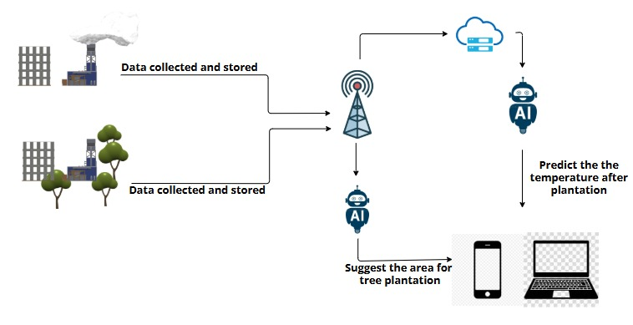
System Diagram

Slide 11
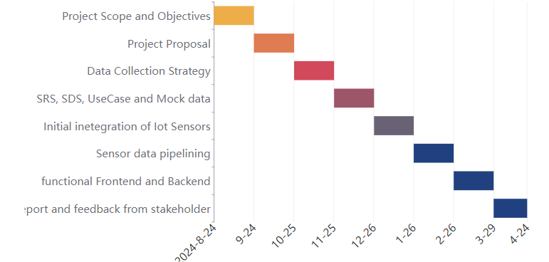
Gantt Chart

Slide 12
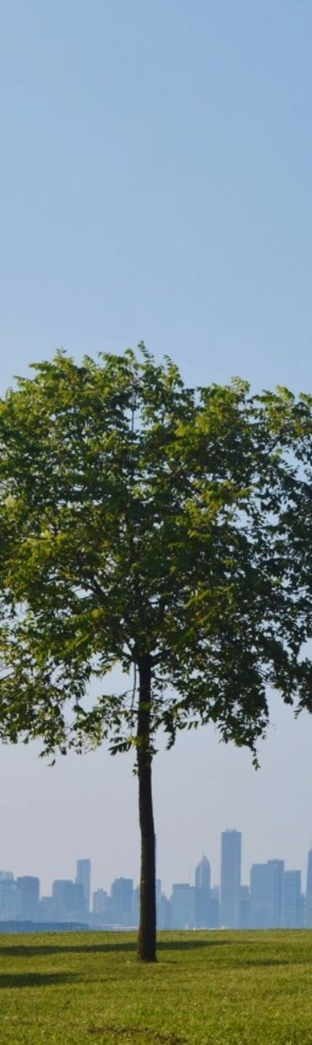
Conclusion
The AI-Enhanced Regional Tree Planting Planner — which leverages IoT data and artificial intelligence models — presents a progressive approach toward urban greening initiatives. This approach is similar to the monitoring system implemented in Punjab using satellites where environmental data is gathered in real time within specific states.

Slide 13
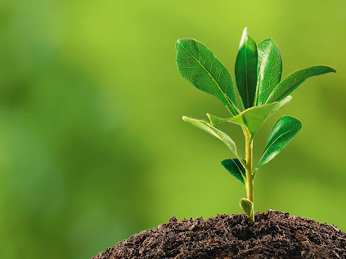
Thank You for your kind, Attention!

